Slide 1

Exploratory Data Analysis (EDA) of Industry Dataset
Industry Performance and Business Insights
Presented by :
Bhawna Chouhan
Industry Dataset Analysis Project

Slide 2
Project Overview
Objectives Dataset Information
Analyze Dataset 15,000 Records
Find Patterns 12 Features
Study Relationships 6 Numerical Variables
Generate Insights 4 Categorical Variables
Support Decision making 1 Date Variable
Key Objective : Transform raw company data into meaningful business insights
using Exploratory Data Analysis ( EDA ) .

Slide 3
Project Workflow
Dataset
Inspection
Cleaning
Univariate
Outlier
Bivariate
Correlation
Multivariate
Business Insights
Conclusion
The project follows a structured EDA workflow , transforming raw data into business insights .

Slide 4
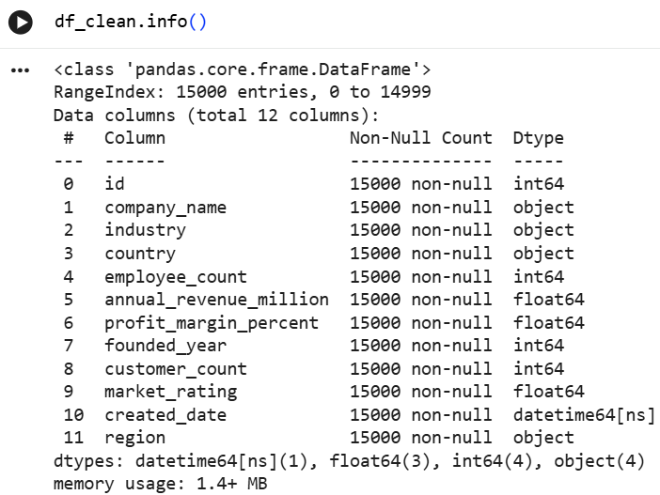
Data Inspection & Cleaning
Data Quality Checks
Data Successfully Loaded
Missing Values Checked
Duplicate Records Checked
Data Types Verified
Date Column Formatted
Dataset Prepared For Analysis
Data Successfully Loaded
The dataset was clean and required minimal preprocessing before analysis .

Slide 5
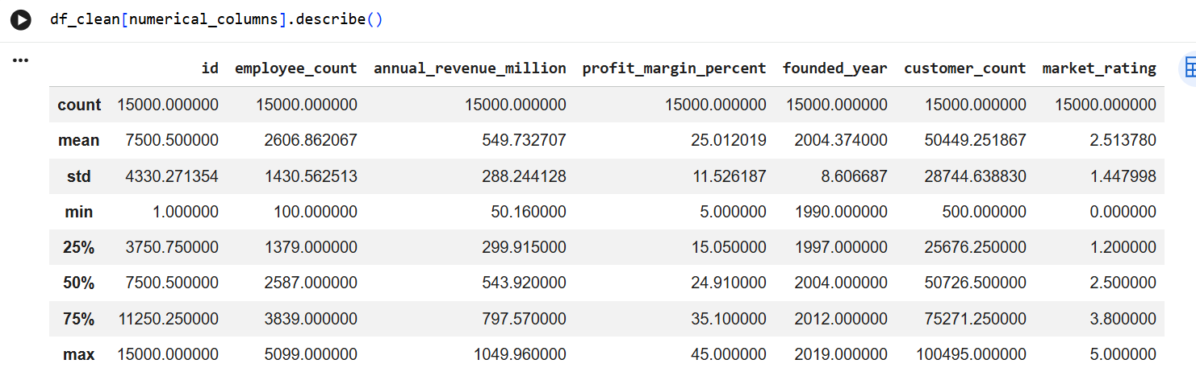
Descriptive Statistics Summary
Revenue and customer counts show large variation across companies ,
indicating differences in business size and market reach .
Used:
Count
Mean
Standard Deviation
Minimum
25th Percentile
Median(50%)
75th Percentile
Maximun

Slide 6
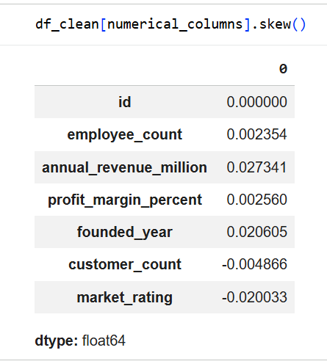
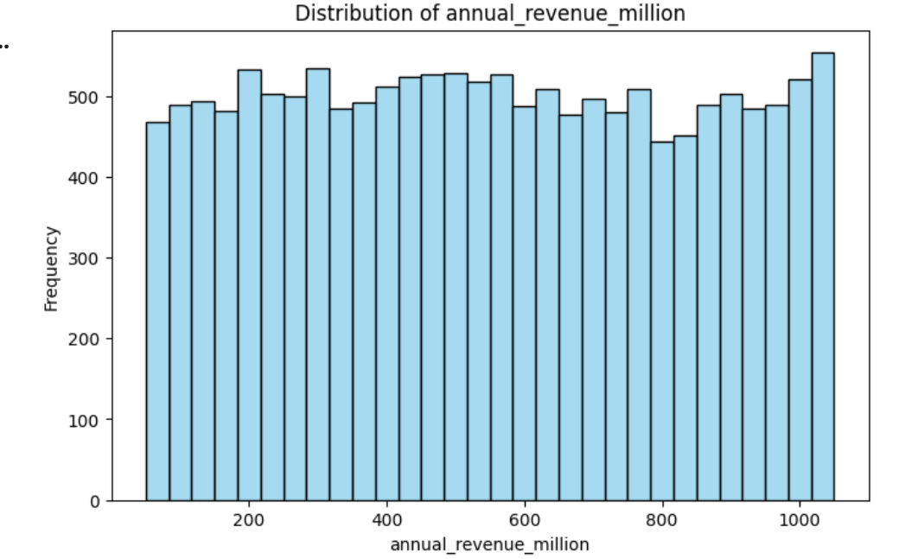
Distribution Analysis
Observation:
Most companies fall within moderate ranges.
Revenue distribution is positively skewed.
Employee counts vary significantly.
The distributions indicate that most companies operate at moderate scales, while
a few large organizations contribute to extreme values in the datasets .

Slide 7
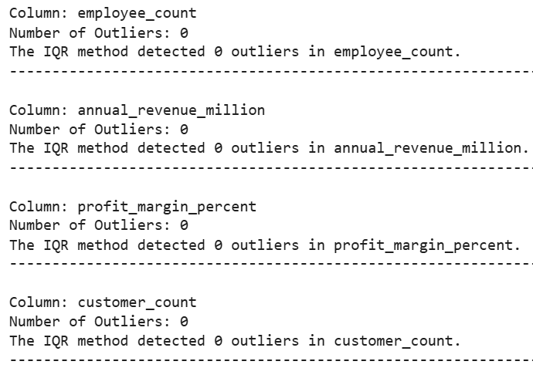
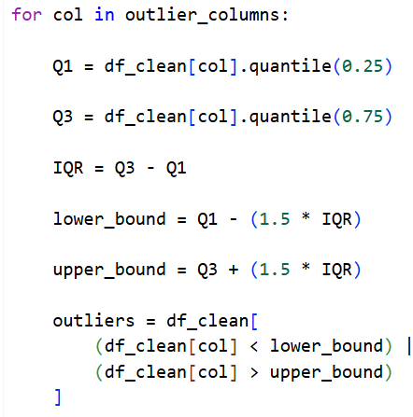
Outlier Analysis using IQR Method
Observation:
Outliers were detected using IQR method.
Most observations lie within the normal range.
A few companies operate at significantly larger scales.
Outliers are not data error . They represent genuine large organizations with exceptional business performance.

Slide 8
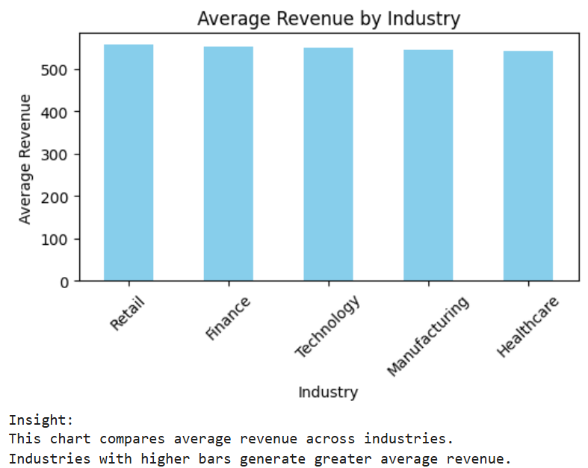
Bivariate Analysis
Purpose :
Analyze relationships
Identify trends
Measure correlation
Observations:
Revenue generally increases with company size.
Larger organizations tend to generate higher revenue.
Relationship strength measured using correlation method.
Business performance is influenced by multiple factors.
Bivariate analysis helps identify how changes in one business variable are associated with another variable.

Slide 9
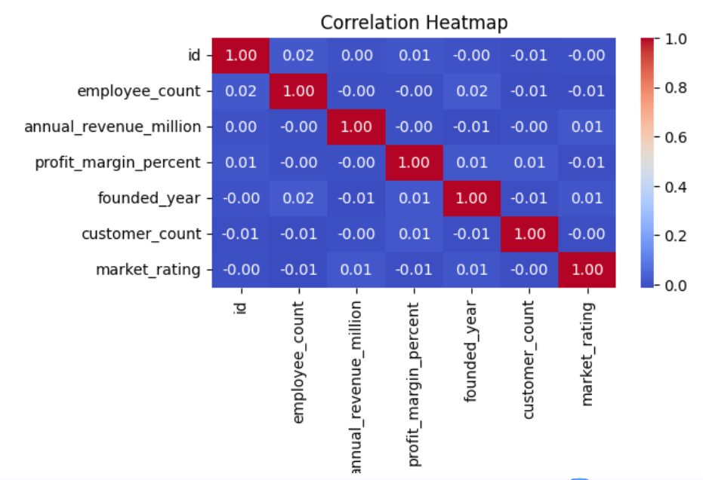
Correlation Analysis
Observations:
Variables show varying levels of correlation.
Some relationships are positive and others are weak.
No single variable explains business performance completely.
Multiple factors influence organizational outcomes.
The Heatmap provides a complete view of relationships among numerical and helps identify important business drivers.
Correlation Interpretation:
+1: Strong Positive relationship
0 : No relationship
-1: Strong negative relationship

Slide 10
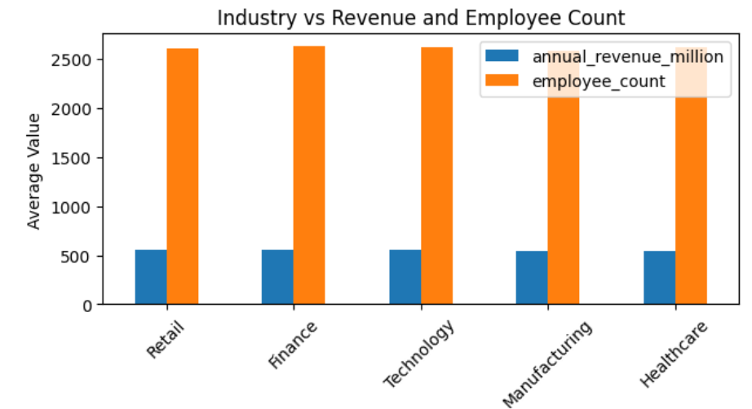
Multivariate Analysis
Observations:
Industries differ in revenue generation.
Workforce size varies across industries.
Some industries achieve higher revenue with fewer employees.
Business performance depends on multiple factors.
Multivariate analysis provides a broader understanding of business performance by combining multiple variables in a single analysis.
Purpose:
Compare multiple business variables
Identify industry performance
Evaluate workforce and revenue trends
Discover deeper business patterns

Slide 11
Key Business Insights
Revenue:
Most companies operate at moderate revenue levels.
Workforce:
Employee counts vary significantly across companies.
Outliers:
Large organizations appear as genuine outliers.
Industry:
Business performance differs across industries.
Region:
Regional variations influence business outcomes.
Relationships:
Multiple factors collectively impact performance.
EDA transformed raw company data into meaningful business insights and decision-support information.

Slide 12
Conclusion
Data successfully analyzed
Data quality verified and prepared
Patterns and trends identified
Relationships between variables explored
Business insights generated through EDA
EDA successfully transformed ram company data into meaningful insights, helping understand business performance ,trends , and relationships within the industry Dataset.

